Slide 1
About Dataset
This data is available in 4 CSV files
orders_details.csv
orders.csv
pizza_types.csv
pizzas.csv
This project involved analyzing Pizza Hut’s sales data using SQL to uncover actionable insights and drive data-informed business decisions. By executing queries across three complexity tiers—basic, intermediate, and advanced—the analysis revealed critical trends in customer behavior, revenue drivers, and operational efficiency.

Slide 2
Basic Queries
Retrieve the total number of orders placed.
Calculate the total revenue generated from pizza sales.
Identify the highest-priced pizza.
Identify the most common pizza size ordered.
List the top 5 most ordered pizza types along with their quantities.

Slide 3
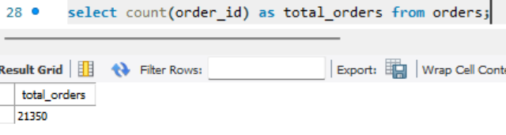
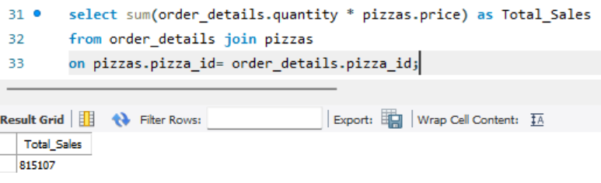
Q.1. Retrieve the total number of orders placed.
Q.2. Calculate the total revenue generated from pizza sales.

Slide 4
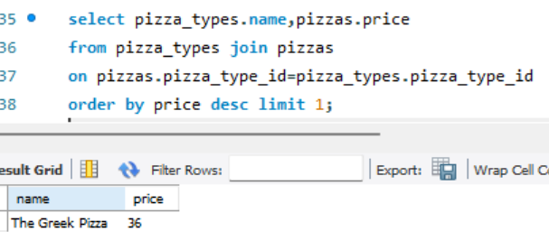
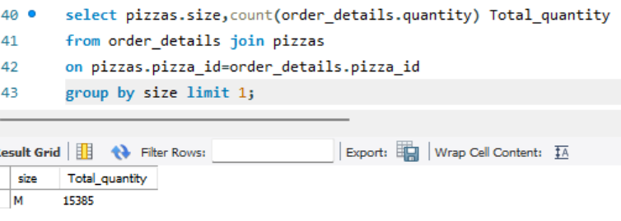
Q.3. Identify the highest-priced pizza.
Q4. Identify the most common pizza size ordered.

Slide 5
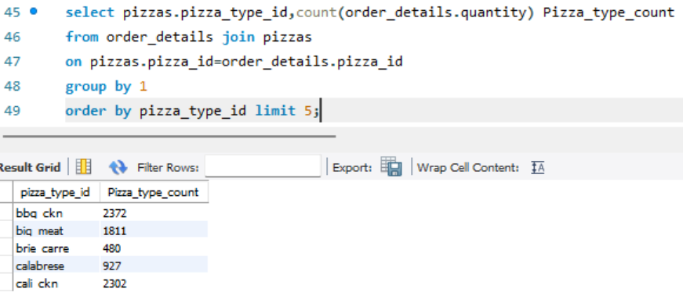
Q.5. List the top 5 most ordered pizza types along with their quantities.

Slide 6
Intermediate Queries
Join the necessary tables to find the total quantity of each pizza category ordered.
Determine the distribution of orders by hour of the day.
Join relevant tables to find the category-wise distribution of pizzas.
Group the orders by date and calculate the average number of pizzas ordered per day.
Determine the top 3 most ordered pizza types based on revenue.

Slide 7
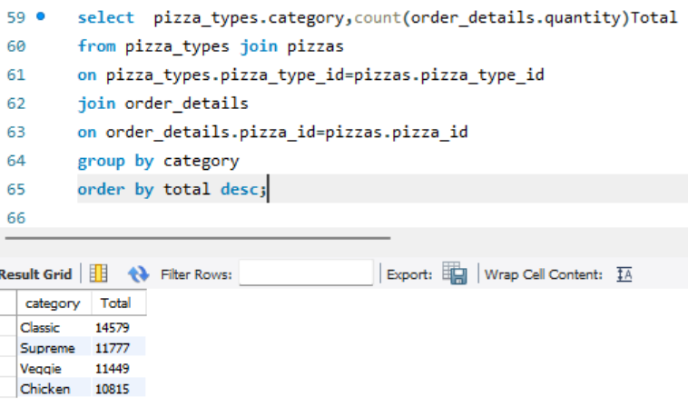
Q.1. Join the necessary tables to find the total quantity of each pizza category ordered.

Slide 8
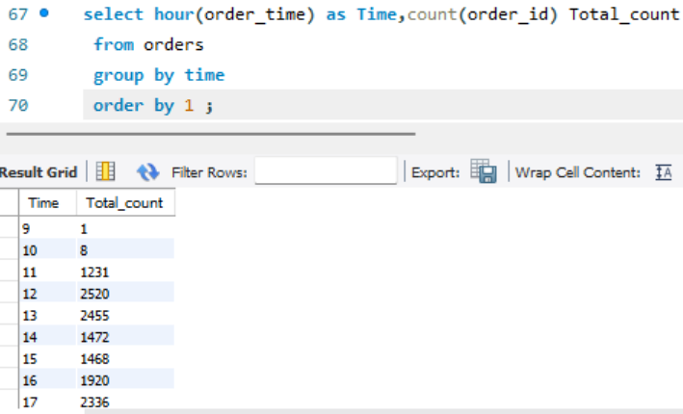
Q.2. Determine the distribution of orders by hour of the day.

Slide 9
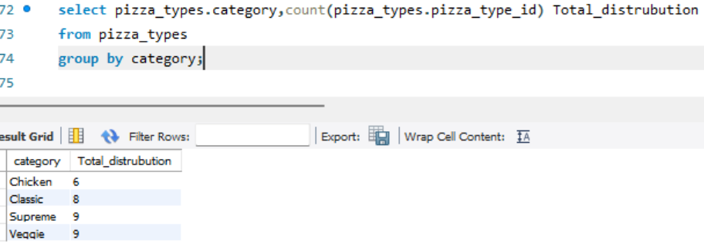
Q.3. Join relevant tables to find the category-wise distribution of pizzas.

Slide 10
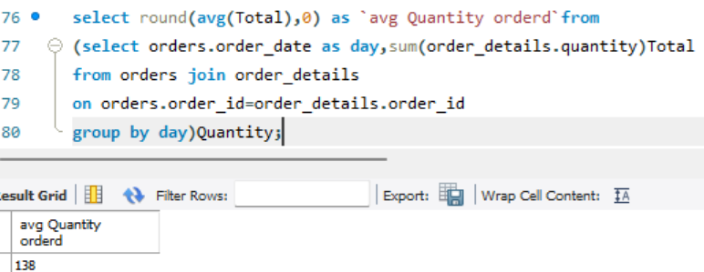
Q.4. Group the orders by date and calculate the average number of pizzas ordered per day.

Slide 11
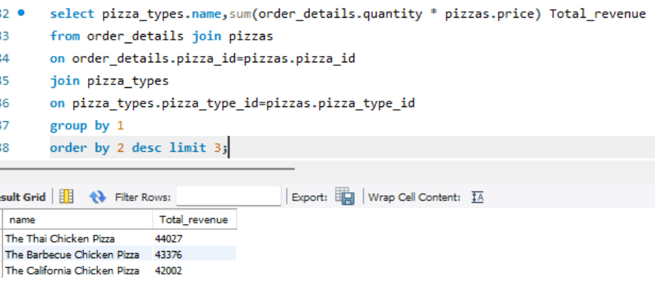
Q.5. Determine the top 3 most ordered pizza types based on revenue.

Slide 12
Advanced Queries
Calculate the percentage contribution of each pizza type to total revenue.
Analyze the cumulative revenue generated over time.
Determine the top 3 most ordered pizza types based on revenue for each pizza category.

Slide 13
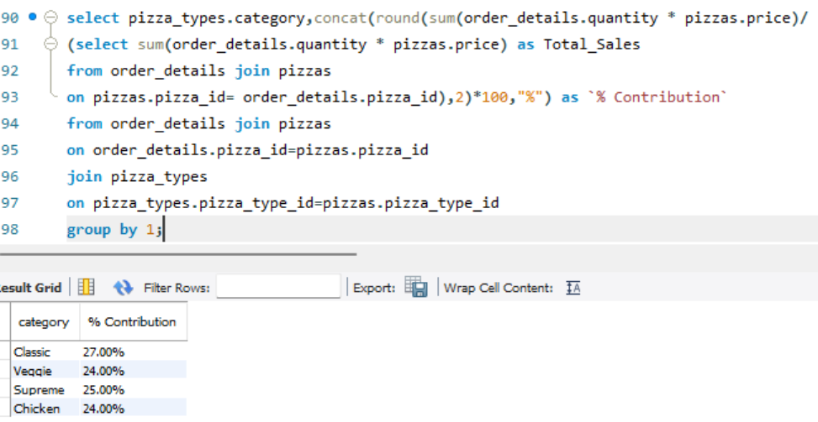
Q.1. Calculate the percentage contribution of each pizza type to total revenue.

Slide 14
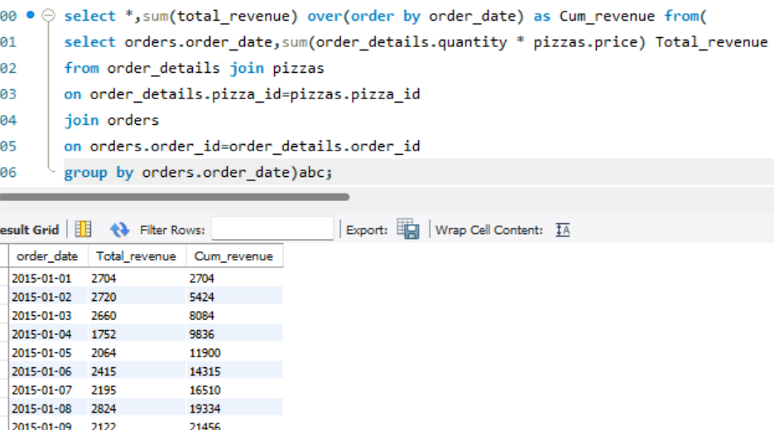
Q.2. Analyze the cumulative revenue generated over time.

Slide 15
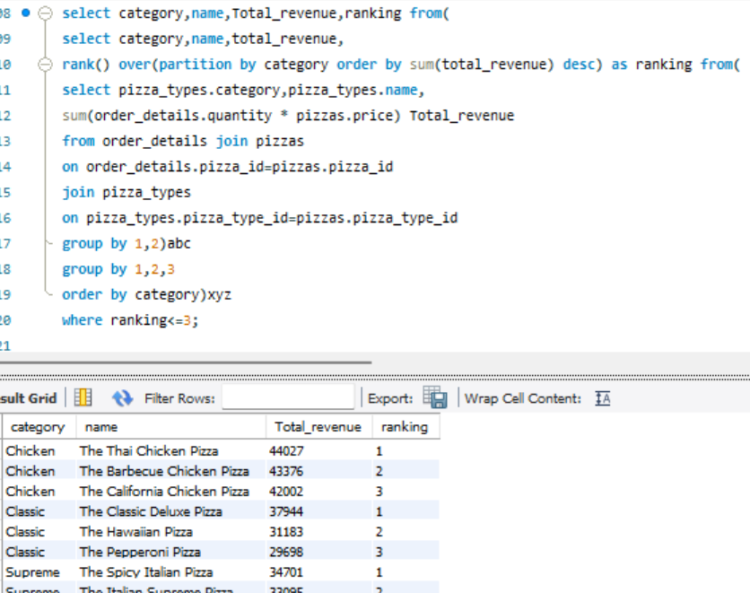
Q.3. Determine the top 3 most ordered pizza types based on revenue for each pizza category.

